Slide 1
Virtual Machines
The base of Linux

Slide 2
Using the Linux OS
Linux can be used on a physical machines as well as a virtual machine
We’ll be installing Ubuntu onto a Virtual Machine
To install Ubuntu or any other Linux OS, you need the .iso file
This file is not ran, but rather mounted to a virtual machine
Has all of the system files needed to install the OS onto a machine

Slide 3
What is a Virtual Machine?
A Virtual Machine is a way of emulating a computer system
We can use the host machine’s resources for a virtual machine
We can create these virtual machines locally or through the Cloud (e.g. AWS, Azure, Google Cloud)
We use tools known as Hypervisors to customise and manage the virtual machines
These hypervisors will manage the resources shared between a host machine and a virtual machine
We can share the network capabilities between a virtual machine and its host

Slide 4
VirtualBox – The Hypervisor
VirtualBox is a hypervisor used for the management of virtual machines
It’s free and open-source, supports a number of OS types and allows for full virtualisation
Networking is also quite customisable through VirtualBox

Slide 5
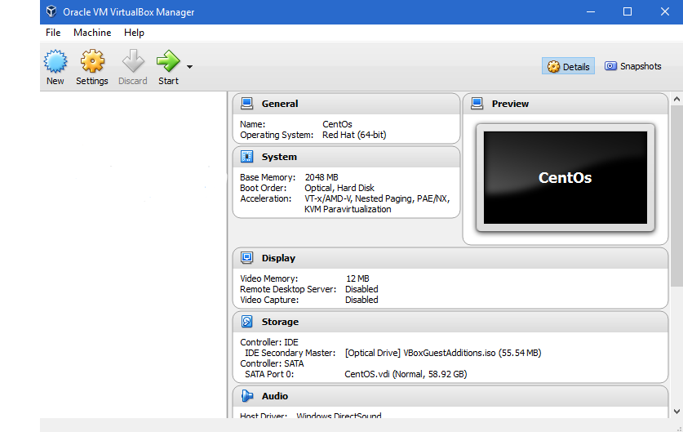
Linux Virtual Machine - VirtualBox

Slide 6
Updating packages
Updating packages ensures that you have the most up-to-date software available
Apt-get update or yum update will do this for Ubuntu or CentOS respectively
Apt and yum are package managers that handle the software on our system
Best practice is to do an update before any install
To install a package, you can use apt-get install [package name]

Slide 7
Thank you
QA hopes you enjoyed your course,
as much as we enjoyed teaching you.

